Slide 1
Unit 4
(Data Pre‐processing, Data Transformation, Data Reduction, Feature Extraction)

Slide 2
Data Pre-processing
Data pre-processing is the first and most critical step in the data science and machine learning pipeline. Real-world data collected from sources such as sensors, databases, surveys, or web applications is often incomplete, noisy, inconsistent, and unstructured. Using such raw data directly for analysis leads to inaccurate results.
Data pre-processing involves cleaning, organizing, and preparing raw data so that it becomes suitable for analysis, modeling, and decision-making.
Objectives of Data Pre-processing
Improve data quality and reliability
Remove noise and inconsistencies
Handle missing and incorrect values
Convert data into a usable format
Increase the accuracy and performance of machine learning models

Slide 3
Steps in Data Pre-processing
1 Data Cleaning
Data cleaning is the process of identifying and correcting errors in data.
Common Data Issues
Missing values
Duplicate records
Incorrect or inconsistent data
Outliers
Techniques
Missing Value Handling
Replace with mean/median/mode
Remove rows or columns
Predict missing values using ML models
Outlier Detection
Z-score method
Interquartile Range (IQR)
Example: In a student dataset, if the age value is missing, it can be replaced with the average age of all students.

Slide 4
2 Data Integration
Data integration combines data from multiple sources into a unified dataset.
Example: Combining student academic records from the examination department and attendance data from the ERP system.
Challenges:
Different data formats
Duplicate attributes
Naming conflicts
3 Data Transformation
Data transformation converts raw data into an appropriate format for analysis.
Common transformations include:
Normalization
Standardization
Encoding categorical data
Aggregation
4 Data Reduction
Data reduction aims to reduce dataset size without losing essential information.
Example: Reducing a dataset of 1 million customer records to 100,000 representative samples.

Slide 5
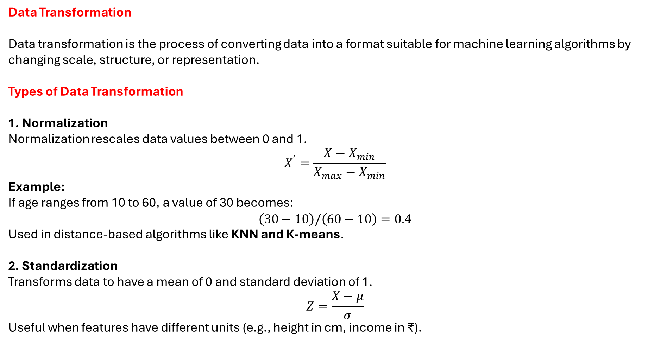
Data Transformation
Data transformation is the process of converting data into a format suitable for machine learning algorithms by changing scale, structure, or representation.
Types of Data Transformation
1. Normalization
Normalization rescales data values between 0 and 1.
$$X^{′}=\frac{X−X_{min}}{X_{max}−X_{min}}$$
Example: If age ranges from 10 to 60, a value of 30 becomes:
$$\left(30−10\right)/\left(60−10\right)=0.4$$
Used in distance-based algorithms like KNN and K-means.
2. Standardization
Transforms data to have a mean of 0 and standard deviation of 1.
$$Z=\frac{X−μ}{σ}$$
Useful when features have different units (e.g., height in cm, income in ₹).

Slide 6
3. Encoding Categorical Variables
Converts categorical data into numerical form.
Label Encoding: Assigns numeric labels (Male=0, Female=1)
One-Hot Encoding: Creates binary columns for each category
Example: Color → Red, Blue, Green → [1,0,0], [0,1,0], [0,0,1]
4. Aggregation
Combines multiple records into a single value.
Example: Daily sales → Monthly sales total.

Slide 7
Data Reduction
Data reduction refers to techniques that reduce the volume of data while preserving important patterns and relationships.
Need for Data Reduction
Improves computational efficiency
Reduces storage cost
Avoids overfitting
Improves model performance
Data Reduction Techniques
1. Dimensionality Reduction
Reduces the number of features (variables).
Principal Component Analysis (PCA)
Converts correlated features into uncorrelated components
Retains maximum variance
Example: Reducing 50 features to 10 principal components.

Slide 8
2. Feature Selection
Selects only the most relevant features.
Types:
Filter methods (correlation, chi-square)
Wrapper methods (recursive feature elimination)
Embedded methods (LASSO)
3. Sampling
Selecting a subset of data from a large dataset.
Types:
Random sampling
Stratified sampling
Systematic sampling
4. Data Compression
Reduces storage size using encoding techniques (e.g., PCA, autoencoders).

Slide 9
Feature Extraction
Feature extraction is the process of creating new features from existing data to better represent the underlying problem.
Unlike feature selection, it transforms original variables into new informative features.
Importance of Feature Extraction
Reduces dimensionality
Enhances model performance
Removes redundancy
Improves learning efficiency
Feature Extraction Techniques
1. Principal Component Analysis (PCA)
Transforms correlated variables into uncorrelated principal components ranked by variance.
Example: Used in face recognition and image compression.
2. Linear Discriminant Analysis (LDA)
Maximizes separation between classes.
Used in classification problems.

Slide 10
3. Feature Extraction in Text Data
Bag of Words (BoW)
TF-IDF
Word embeddings (Word2Vec, GloVe)
4. Feature Extraction in Image Data
Edge detection
Texture analysis
Histogram of Oriented Gradients (HOG)

Slide 11
Difference Between Data Pre-processing, Transformation, Reduction & Feature Extraction
Aspect | Pre-processing | Transformation | Reduction | Feature Extraction
Purpose | Clean data | Change format | Reduce size | Create new features
Output | Clean data | Transformed data | Compact data | Informative features
Methods | Cleaning, integration | Scaling, encoding | PCA, sampling | PCA, LDA, embeddings
Example | Remove nulls | Normalize values | Reduce dimensions | Extract text features
Data pre-processing, transformation, reduction, and feature extraction form the foundation of effective data analytics and machine learning. These steps ensure high-quality data, reduce complexity, improve model accuracy, and enable better decision-making. Without these processes, even the most advanced algorithms cannot deliver reliable results.

